Slide 1
JavaServer Faces Lifecycle

Slide 2
Two phases
The lifecycle of a JavaServer Faces application begins when the client makes an HTTP request for a page and ends when the server responds with the page.
JSF Lifecycle is divided into 2 phases:
Execute phase
Render phase

Slide 3
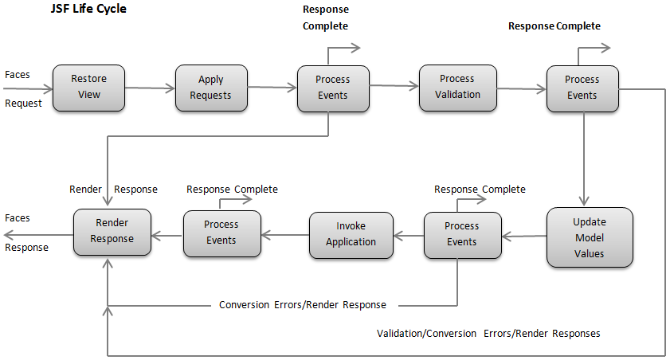

Slide 4
1) Execute Phase
In execute phase, when first request is made, application view is built or restored. For other subsequent requests other actions are performed like request parameter values are applied, conversions and validations are performed for component values, managed beans are updated with component values and application logic is invoked.

Slide 5
Subphases of execute phase
Restore View Phase
Apply Request Values Phase
Process Validations Phase
Update Model Values Phase
Invoke Application Phase
Render Response Phase

Slide 6
i. Restore View Phase
This phase begins each time a consumer requests a JSF page by simply clicking on a link, button and so on. In this page view generation, the binding of components to the event handlers and validators is performed as well as the view is preserved within the FacesContext object.

Slide 7
ii. Apply Request Values Phase
The objective of this phase is made for each component to retrieve the current state.

Slide 8
iii. Process Validations Phase
In this phase, local values stored to get the component in the tree will be in comparison to the validation rules authorized to get the components.

Slide 9
iv. Update Model Values Phase
Following verifying that data is valid in the last phase local values of elements could be started related to server-based object properties, for example, backing beans.

Slide 10
v. Invoke Application Phase
Ahead of this phase the component values had been transformed, validated, as well as, put on the bean objects so that you can utilize these to perform the application’s business logic.

Slide 11
vi. Render Response Phase
This phase fetches a new view if needed using values from server-side beans then we output the view using the values that are in the tree and then for beans that are not on the request in other words on the session scope or application scope we will then save those the current state.

Slide 12
2) Render phase
In this phase, the requested view is rendered as a response to the client browser. View rendering is a process in which output is generated as HTML or XHTML. So, user can see it at the browser.

Slide 13
The following steps are taken during the render process.
Application is compiled, when a client makes an initial request for the index.xhtml web page.
Application executes after compilation and a new component tree is constructed for the application and placed in a FacesContext.
The component tree is populated with the component and the managed bean property associated with it, represented by the EL expression.
Based on the component tree. A new view is built.
The view is rendered to the requesting client as a response.
The component tree is destroyed automatically.
On subsequent requests, the component tree is rebuilt, and the saved state is applied.

